Slide 1
ANDROID Data Storage & Access Part 1

Slide 2
Overview
Several options to store app data.
App-specific storage: Store files that are meant for your app's use only, either in dedicated directories within an internal storage volume or different dedicated directories within external storage. Use the directories within internal storage to save sensitive information that other apps shouldn't access.
Shared storage: Store files that your app intends to share with other apps, including media, documents, and other files.
Preferences: Store private, primitive data in key-value pairs.
Databases: Store structured data in a private database using the Room persistence library/ SQLite
Network Storage: Store and sync data across multiple clients using Firebase (Real time Database).

Slide 3
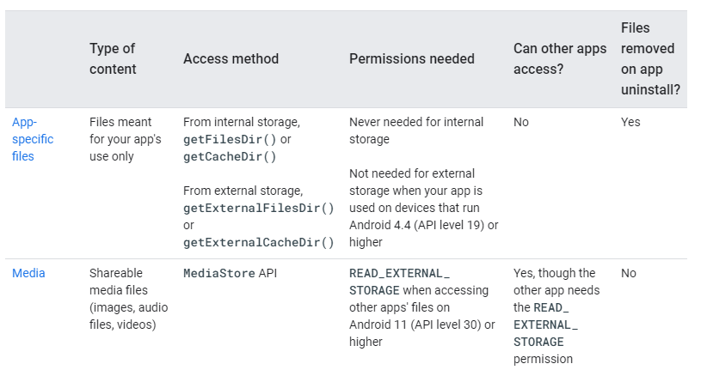
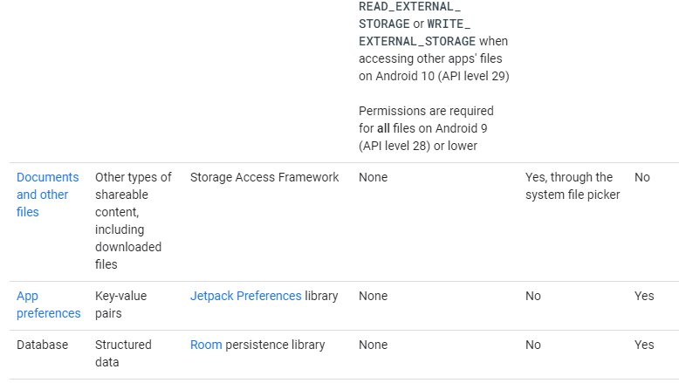

Slide 4
Selecting Storage Type
How much space does your data require?
Internal storage has limited space for app-specific data. Use other types of storage if you need to save a substantial amount of data.
How reliable does data access need to be?
If your app's basic functionality requires certain data, such as when your app is starting up, place the data within internal storage directory or a database. App-specific files that are stored in external storage aren't always accessible because some devices allow users to remove a physical device that corresponds to external storage.
What kind of data do you need to store?
If you have data that's only meaningful for your app, use app-specific storage. For shareable media content, use shared storage so that other apps can access the content. For structured data, use either preferences (for key-value data) or a database (for data that contains more than 2 columns).
Should the data be private to your app?
When storing sensitive data—data that shouldn't be accessible from any other app—use internal storage, preferences, or a database. Internal storage has the added benefit of the data being hidden from users.

Slide 5
App Specific Storage
There are Two types of App Specific Storage
Internal storage directories: These directories include both a dedicated location for storing persistent files, and another location for storing cache data. The system prevents other apps from accessing these locations, and on Android 10 (API level 29) and higher, these locations are encrypted. These characteristics make these locations a good place to store sensitive data that only your app itself can access.
External storage directories: These directories include both a dedicated location for storing persistent files, and another location for storing cache data. Although it's possible for another app to access these directories if that app has the proper permissions, the files stored in these directories are meant for use only by your app. If you specifically intend to create files that other apps should be able to access, your app should store these files in the shared storage part of external storage instead.

Slide 6

Internal Storage
For each app, the system provides directories within internal storage where an app can organize its files.
One directory is designed for your app's persistent files
Another contains your app's cached files.
Your app doesn't require any system permissions to read and write to files in these directories.
You can use the File API to access and store files.
Your app's ordinary, persistent files reside in a directory that you can access using the FilesDir property of a context object.

Slide 7
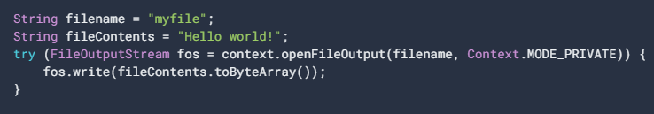
Internal Storage (Using Stream)
As an alternative to using the File API for storing data, you can call openFileOutput() to get a FileOutputStream that writes to a file within the FilesDir directory.
To allow other apps to access files stored in this directory within internal storage, use a FileProvider with the FLAG_GRANT_READ_URI_PERMISSION attribute.

Slide 8
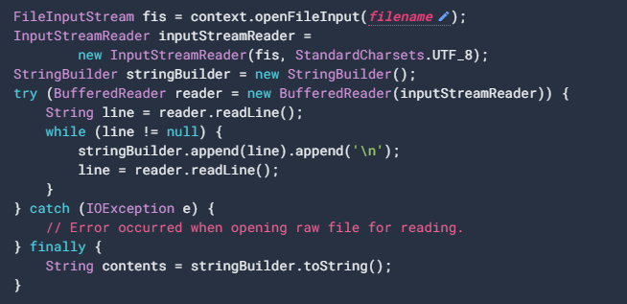
Internal Storage (Using Stream)
To read a file as a stream, use openFileInput() to get a FileInputStream :

Slide 9
External Storage
If internal storage doesn't provide enough space to store app-specific files, consider using external storage instead.
The system provides directories within external storage where an app can organize files that provide value to the user only within your app.
One directory is designed for your app's persistent files
Another contains your app's cached files.
On Android 4.4 (API level 19) or higher, your app doesn't need to request any storage-related permissions to access app-specific directories within external storage.
On devices that run Android 9 (API level 28) or lower, your app can access the app-specific files that belong to other apps, provided that your app has the appropriate storage permissions

Slide 10
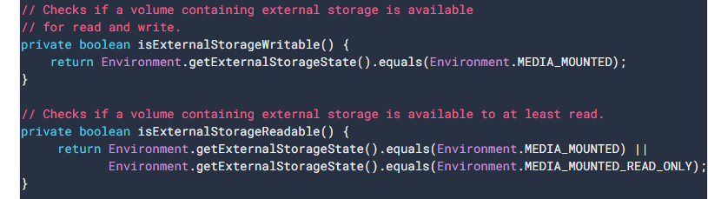
External Storage (Storage Availability)
External storage resides on a physical volume that the user might be able to remove, verify that the volume is accessible before trying to read app-specific data from, or write app-specific data to, external storage.
You can query the volume's state by calling Environment.getExternalStorageState().
If the returned state is MEDIA_MOUNTED, then you can read and write app-specific files within external storage.
If it's MEDIA_MOUNTED_READ_ONLY, you can only read these files.

Slide 11
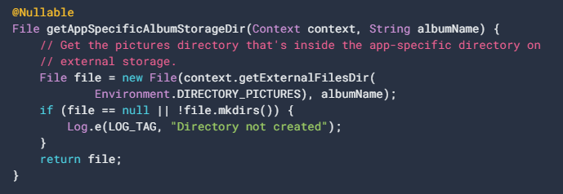
External Storage
To access app-specific files from external storage, call getExternalFilesDir().
If your app works with media files that provide value to the user only within your app, it's best to store them in app-specific directories within external storage:
Public Directories
The Environment class has constants for common public directories: Environment.DIRECTORY_ALARMS - audio files that should be in the list of alarms that the user can select Environment.DIRECTORY_DCIM - traditional location for pictures and videos when mounting the device as a camera Environment.DIRECTORY_DOWNLOADS Environment.DIRECTORY_MOVIES Environment.DIRECTORY_MUSIC Environment.DIRECTORY_NOTIFICATIONS - audio files that should be in the list of notifications that the user can select Environment.DIRECTORY_PICTURES Environment.DIRECTORY_PODCASTS Environment.DIRECTORY_RINGTONES

Slide 12

Shared Preferences
If you have a relatively small collection of key-values that you'd like to save, you should use the SharedPreferences APIs.
A SharedPreferences object points to a file containing key-value pairs and provides simple methods to read and write them.
You can create a new shared preference file or access an existing one by calling one of these methods:
getSharedPreferences() — Use this if you need multiple shared preference files identified by name, which you specify with the first parameter. You can call this from any Context in your app.
When naming your shared preference files, you should use a name that's uniquely identifiable to your app. An easy way to do this is prefix the file name with your application ID. For example: "com.example.myapp.PREFERENCE_FILE_KEY"

Slide 13

Shared Preferences
getPreferences() — Use this from an Activity if you need to use only one shared preference file for the activity. Because this retrieves a default shared preference file that belongs to the activity, you don't need to supply a name.
To write to a shared preferences file, create a SharedPreferences.Editor by calling edit() on your SharedPreferences.
Key
Value

Slide 14
ANDROID Data Storage & Access Part 2

Slide 15
Shared Storage
Apps allow users to contribute and access media that's available on an external storage volume
The MediaStore API provides an optimized index into media collections that allows for retrieving and updating these media files more easily.
The system provides standard public directories for these kinds of files, so the user has a common location for all their photos, another common location for all their music and audio files, and so on.
Even after your app is uninstalled, these files remain on the user's device.
If your app works with media files that provide value to the user only within your app, it's best to store them in app-specific directories within external storage.

Slide 16
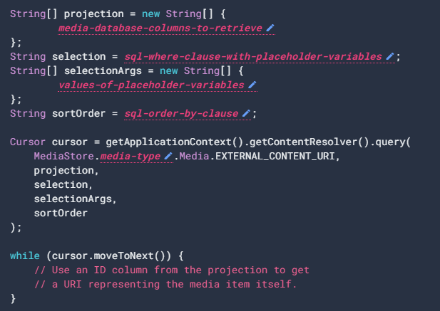
Shared Storage
To interact with the media store abstraction, use a ContentResolver object that you retrieve from your app's context:
The system automatically scans an external storage volume and adds media files to the following well-defined collections:
Images, including photographs and screenshots, which are stored in the DCIM/ and Pictures/ directories. The system adds these files to the MediaStore.Images table.
Videos, which are stored in the DCIM/, Movies/, and Pictures/ directories. The system adds these files to the MediaStore.Video table.

Slide 17
Shared Storage
Audio files, which are stored in the Alarms/, Audiobooks/, Music/, Notifications/, Podcasts/, and Ringtones/ directories, as well as audio playlists that are in the Music/ or Movies/ directories. The system adds these files to the MediaStore.Audio table.
Downloaded files, which are stored in the Download/ directory. On devices that run Android 10 (API level 29) and higher, these files are stored in the MediaStore.Downloads table. This table isn't available on Android 9 (API level 28) and lower.

Slide 18
Database (Room Library)
Room provides an abstraction layer over SQLite to allow fluent database access while harnessing the full power of SQLite.
Apps that handle non-trivial amounts of structured data can benefit greatly from persisting that data locally.
When the device cannot access the network, the user can still browse that content while they are offline.
Any user-initiated content changes are then synced to the server after the device is back online.
SQLite is fairly low-level and require a great deal of time and effort to use.
Room takes care of these concerns so it is highly recommended to use Room instead of SQLite.
No permissions are required for storing and accessing data.
Other apps can not access data that are stored in these local databases.

Slide 19
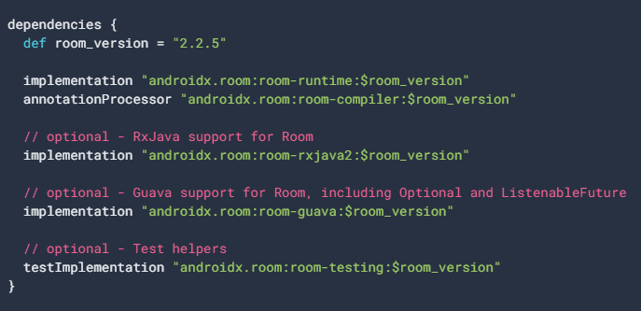
Room Dependencies
To use Room in your app, add the following dependencies to your app's build.gradle file:

Slide 20
Room Components
There are 3 major components in Room:
Database: Contains the database holder and serves as the main access point for the underlying connection to your app's persisted, relational data.
Entity: Represents a table within the database.
DAO: Contains the methods used for accessing the database.

Slide 21
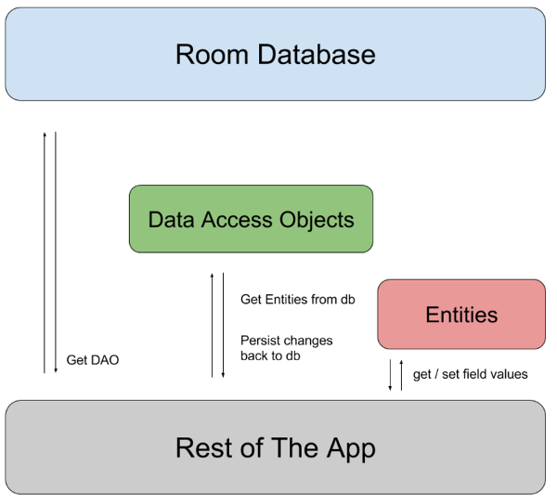
Room Components
The app uses the Room database to get the data access objects, or DAOs, associated with that database.
The app then uses each DAO to get entities from the database and save any changes to those entities back to the database.
Finally, the app uses an entity to get and set values that correspond to table columns within the database.:

Slide 22
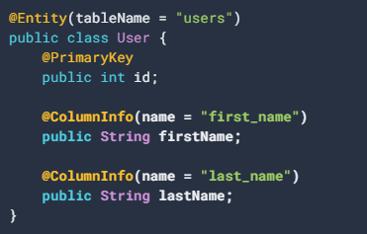
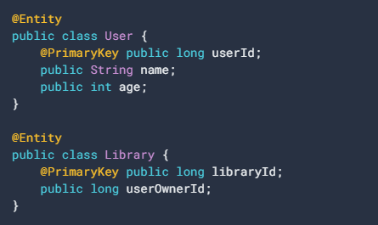
Entity
Represents a table within the database.
@Entity
Primary key
Column Info
Table name

Slide 23
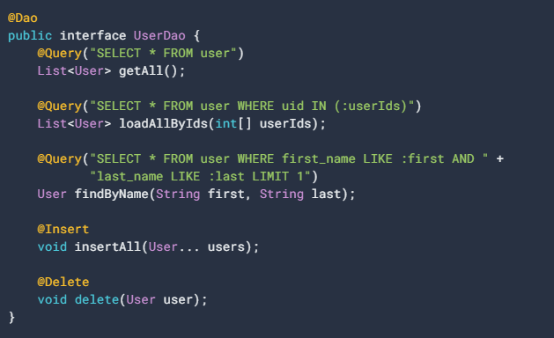
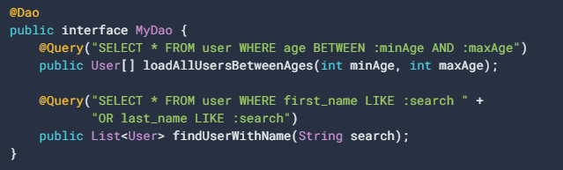
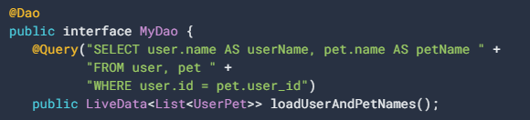
Data Access Objects (Dao)
Instance 1
Instance 2
Instance 3
Dao contains the methods used for accessing the database.
Notes:
public class UserPet { public String userName; public String petName; }

Slide 24
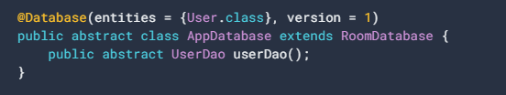

Database
The class that's annotated with @Database should satisfy the following conditions:
Be an abstract class that extends RoomDatabase.
Include the list of entities associated with the database within the annotation.
Contain an abstract method that has 0 arguments and returns the class that is annotated with @Dao.
At runtime, you can acquire an instance of Database by calling Room.databaseBuilder() or Room.inMemoryDatabaseBuilder().
Notes:
UserDao userDao = db.userDao(); List<User> users = userDao.getAll();

Slide 25
THANK YOU

